Slide 1
Building iOS Swift apps
5030-201720_MCS5993_M: 5030-Topics in Computer Science
5031-201720_MCS4993_M: 5031-Topics in MA/CS

Slide 2
Agenda
Tools of the trade
Notes:
Show remarks in iTunesConnect

Slide 3
Unit Testing Benefits

Slide 4
Unit Tests should be First
F(ast)
I(solated)
R(epeatable)
S(elf-verifying)
T(imley)
Notes:
https://pragprog.com/magazines/2012-01/unit-tests-are-first

Slide 5
Tools of the trade
XCTest (last lecture)
Cuckoo
XCUI
Postman
Jenkins

Slide 6
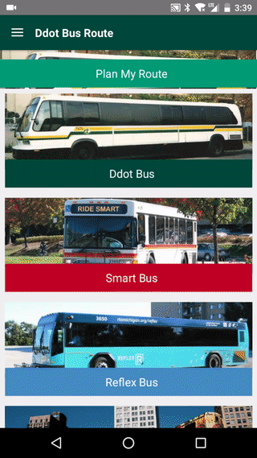
Sample app

Slide 7
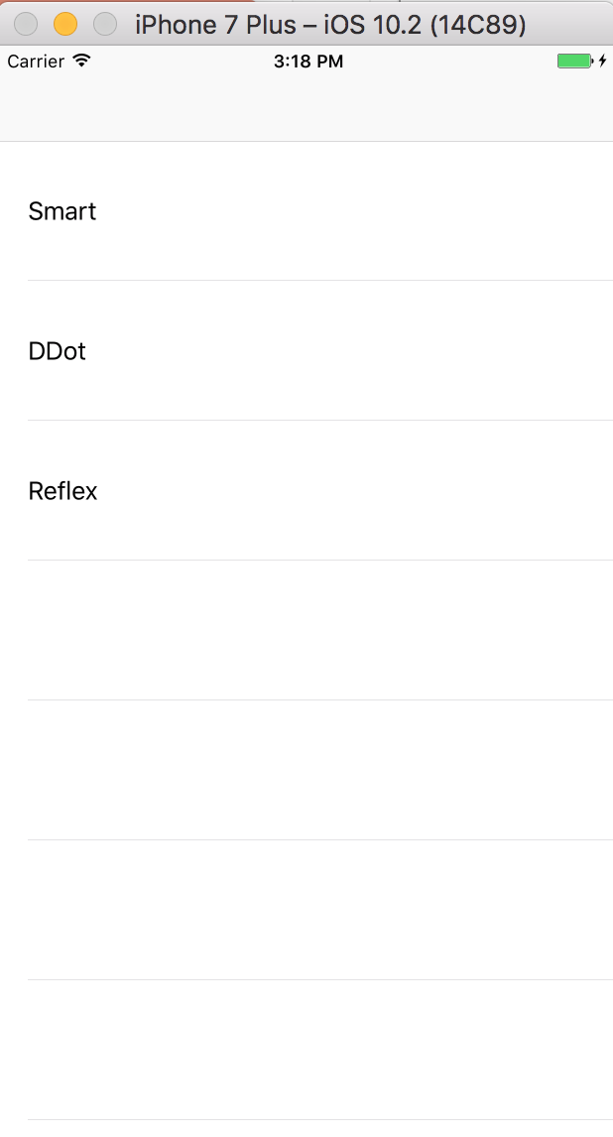
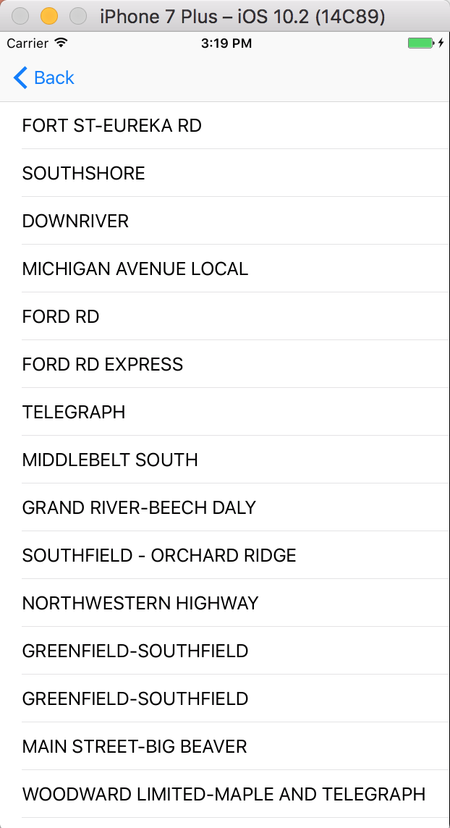
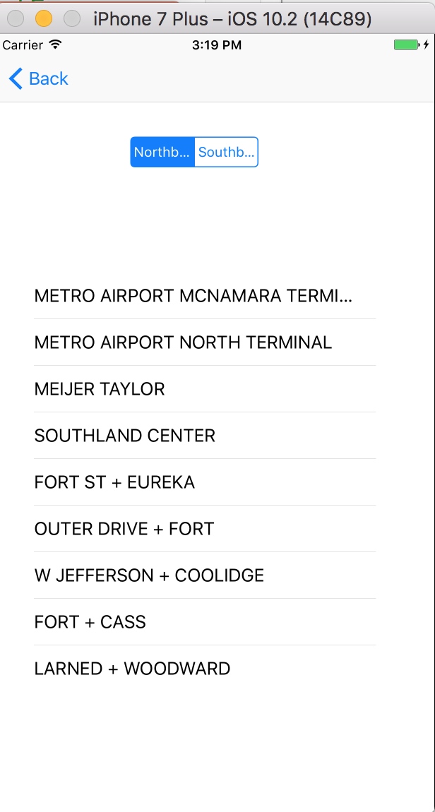
Sample app
Notes:
git clone http://github.com/dfreemanRIIS/ETAMock

Slide 8
Sample App
git clone http://github.com/dfreemanRIIS/ETAMock

Slide 9
Cuckoo
Add Cuckoo to the test target in Podfile
Pod install
Add Run Script to build phases
Add GeneratedMocks.swift file to tests

Slide 10
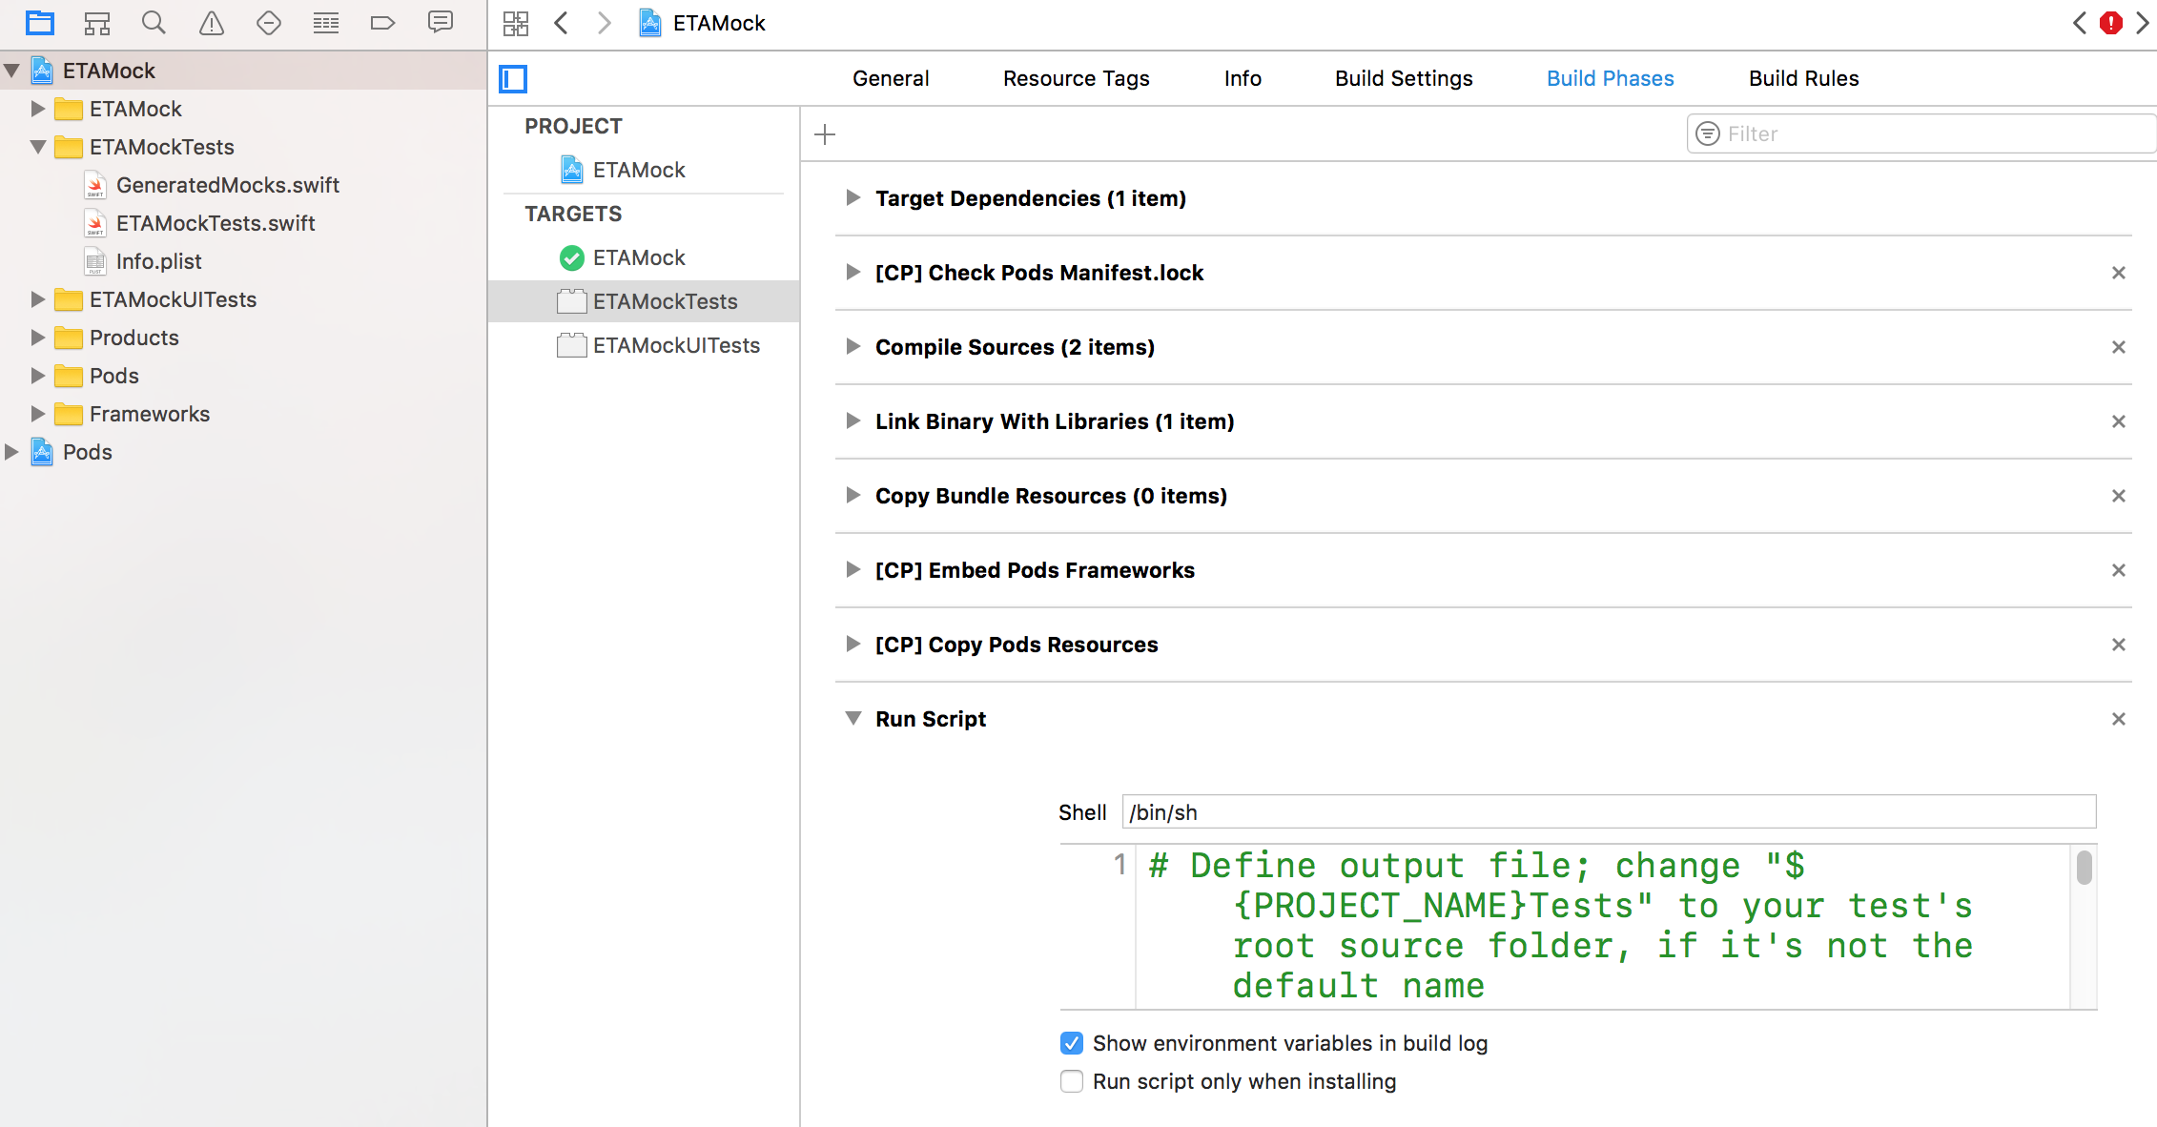
Cuckoo
Notes:
git clone http://github.com/dfreemanRIIS/ETAMock

Slide 11
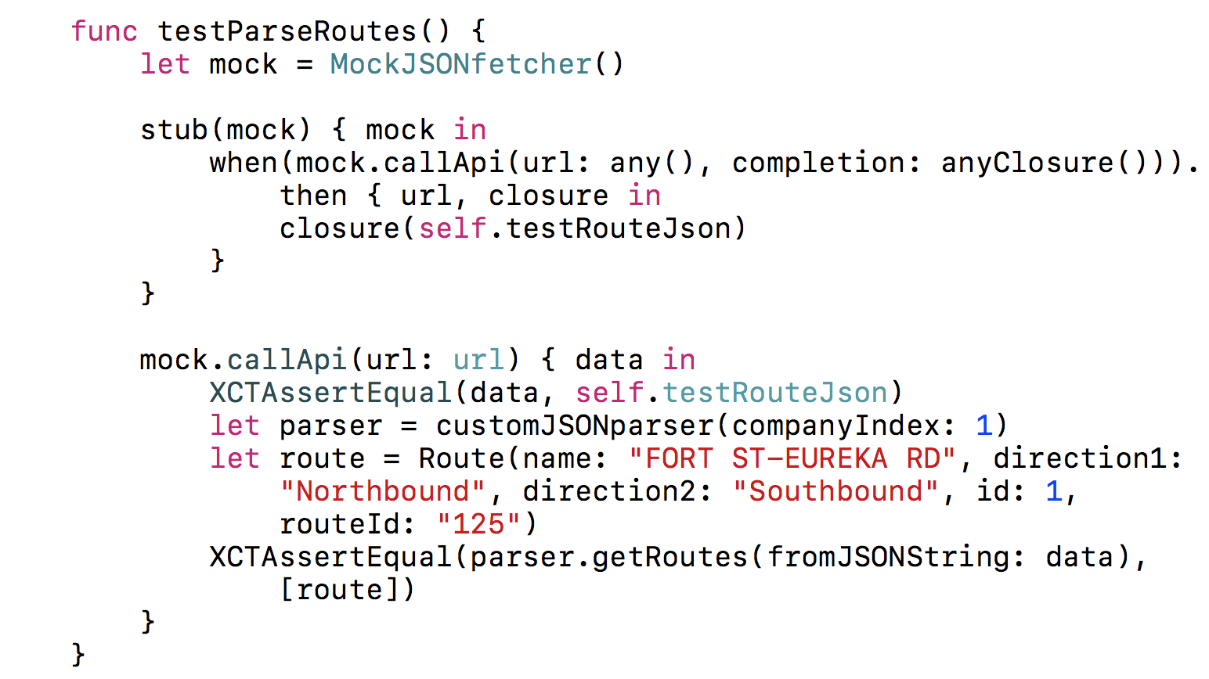
Cuckoo
Notes:
git clone http://github.com/dfreemanRIIS/ETAMock

Slide 12
XCUI
User Interface testing
Two options
Recorded tests
Roll your own

Slide 13
XCUI
XCUI has 3 component parts
XCUIApplication
Launch the app
XCUIElementQuery
Find the XCUI Element to test
XCUIElement
Perform Test

Slide 14
XCUI

Slide 15
XCUI

Slide 16
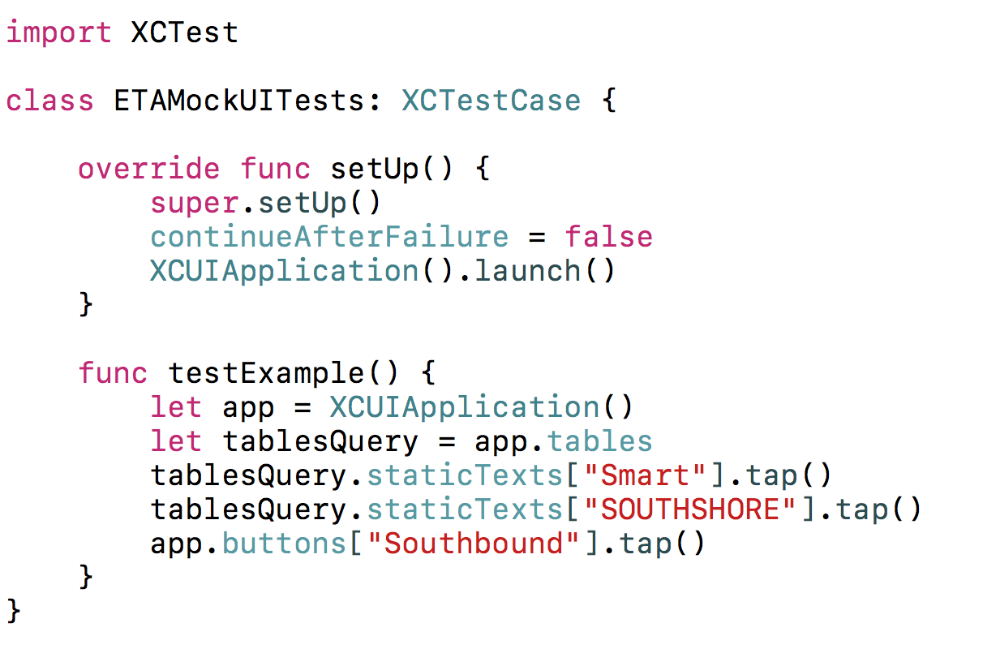
XCUI
Notes:
Run the test

Slide 17
XCUI
Notes:
Run the test

Slide 18
Unit Testing Benefits

Slide 19
Sample App – API calls
List of bus routes
http://localhost:8080/companies/{companyID}/routes
http://ec2-204-236-211-33.compute-1.amazonaws.com:8080/companies/\(companyIndex)/routes
List of stops
http://localhost:8080/companies/{companyID}/routes/{id}/{direction}/{day}/{active}/stops
http://ec2-204-236-211-33.compute-1.amazonaws.com:8080/companies/\(companyIndex!)/routes/\(route.id)/\(direction)/weekday/1/stops
Notes:
http://localhost:8080/companies/{companyID}/routes
http://docs.routeapi1.apiary.io/#reference/0/stops-collection/get-a-companies-stops

Slide 20
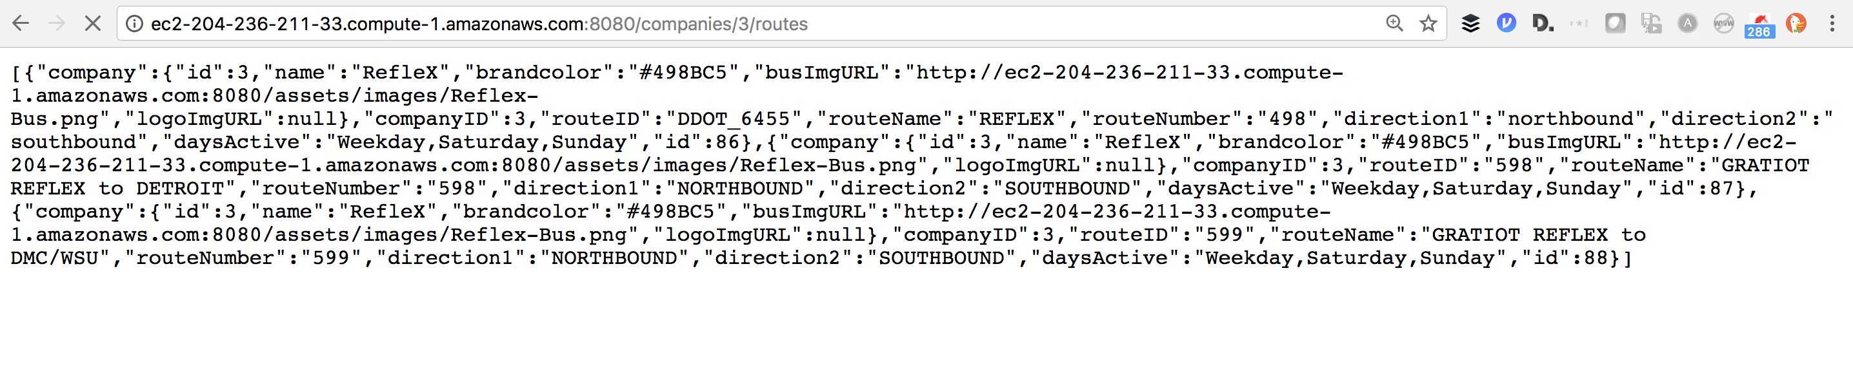
Sample App – API calls

Slide 21
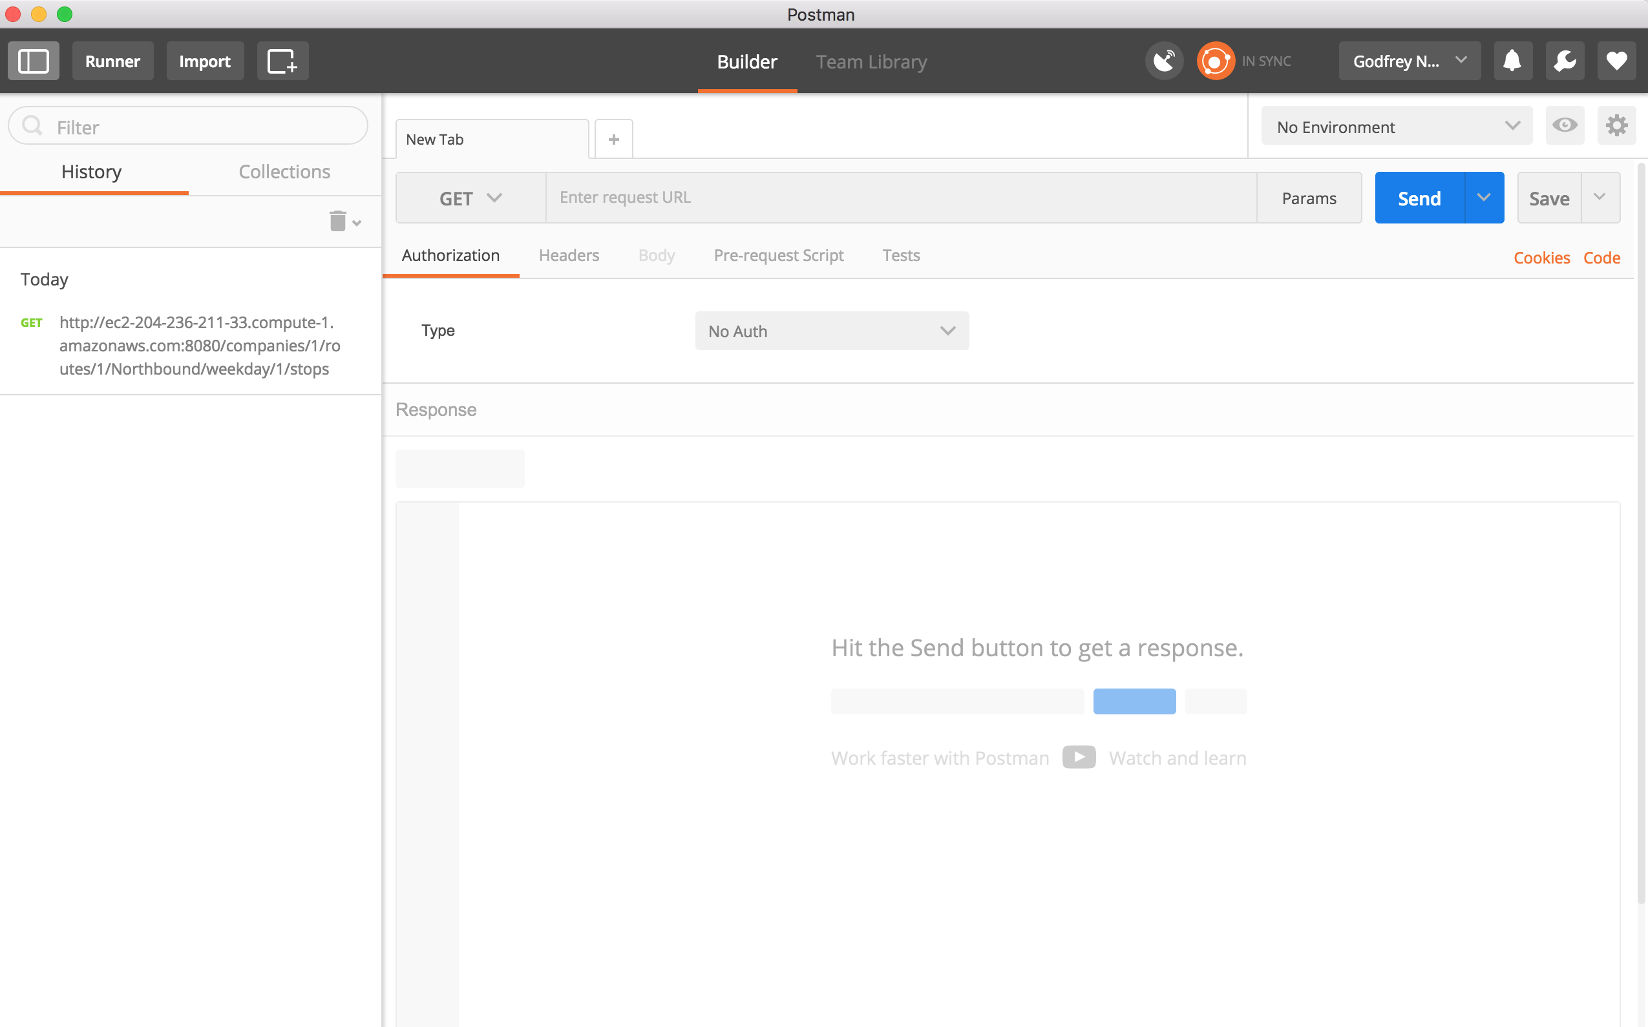
Postman
Notes:
Need json file
https://github.com/dfreemanRIIS/ETAMock/blob/master/ETAJson.postman_collection.json

Slide 22
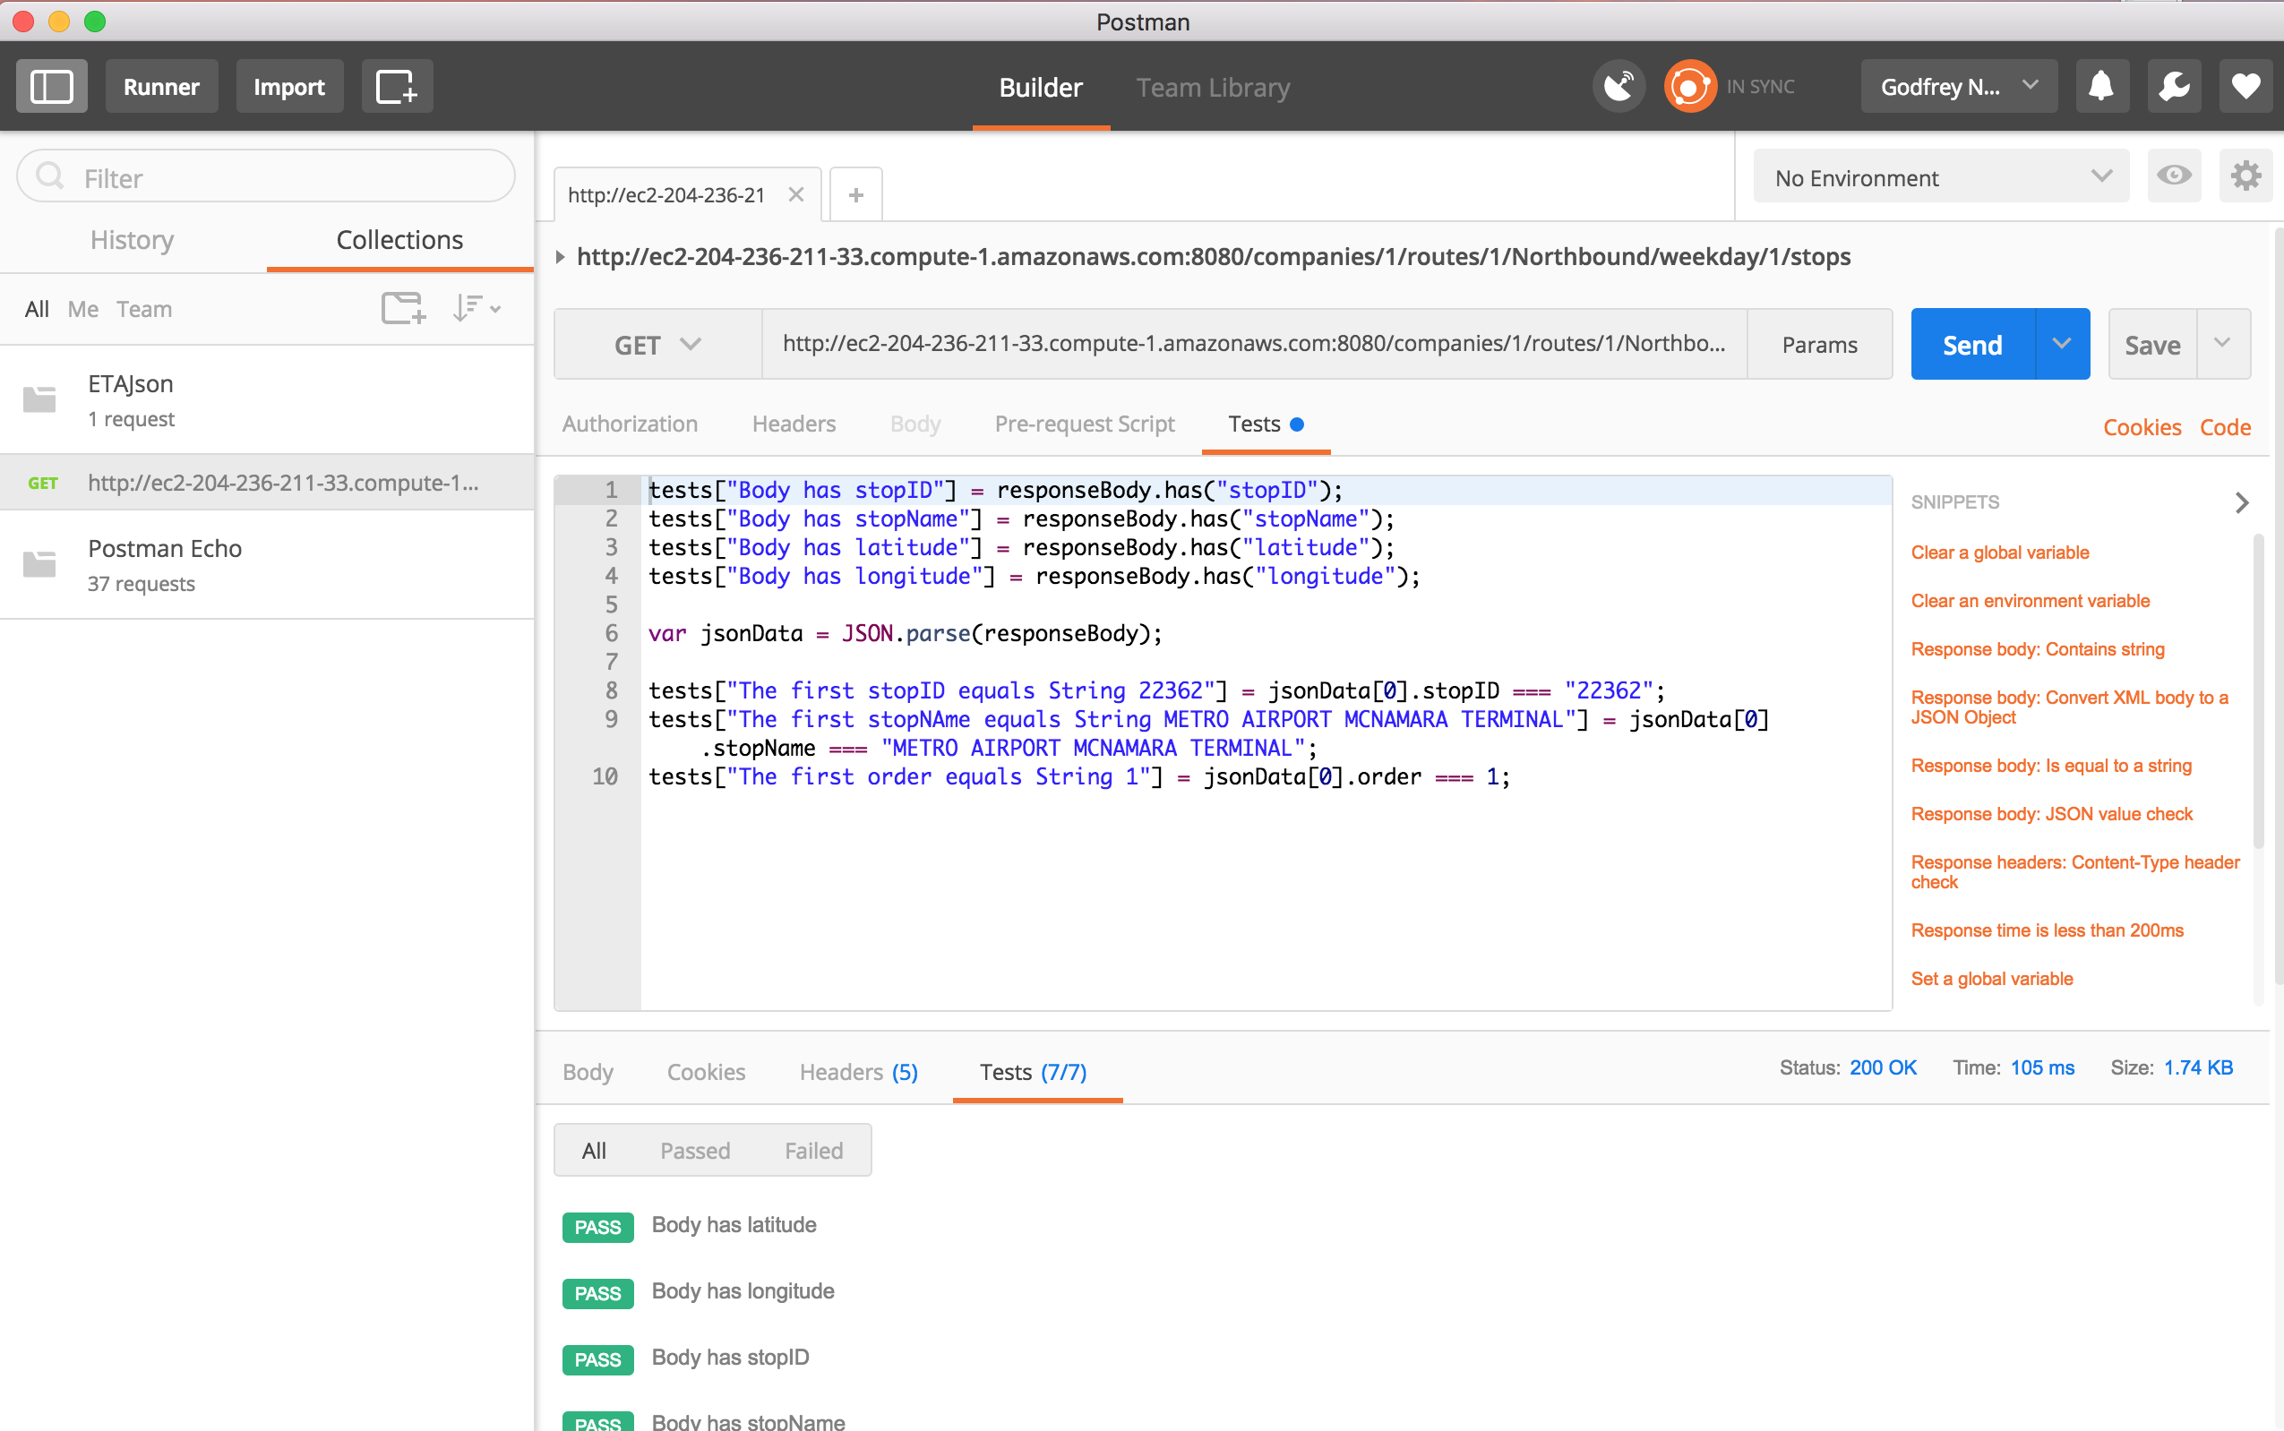
Postman
Notes:
Install newman

Slide 23
Agenda Tuesday
Continuous Integration - Jenkins

